Slide 1
With .NET and AI, our community app "aspires" to be on cloud nine
Augustine Correa

Slide 2
Agenda
01
02
03
What are the pain points
Demo Features
Learnings, Gotchas, etc.

Slide 3
01
Who are we?

Slide 4
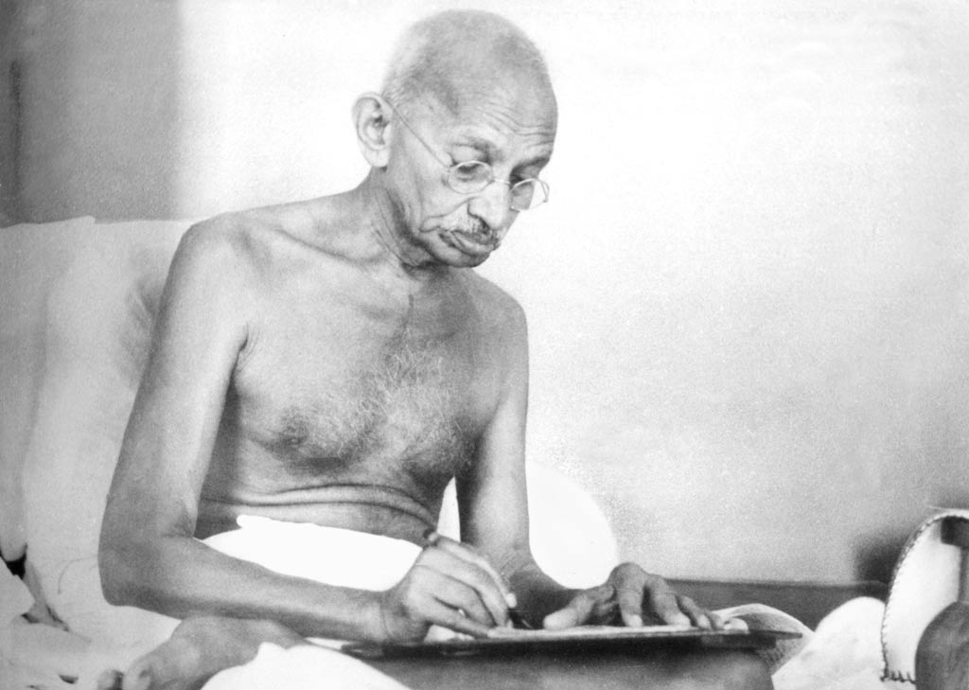
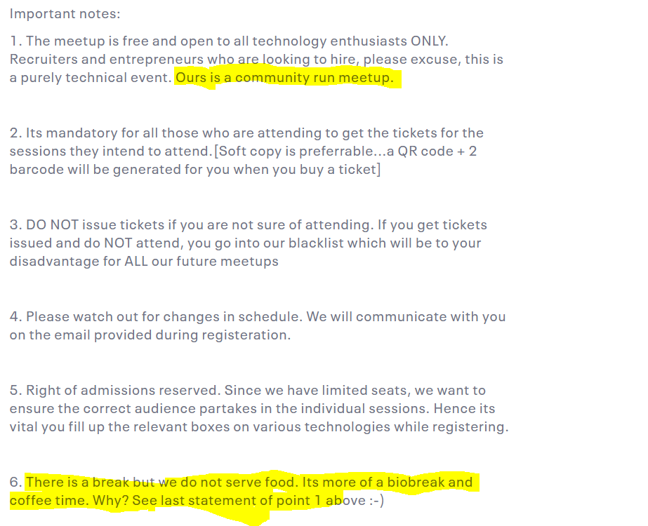


Slide 5
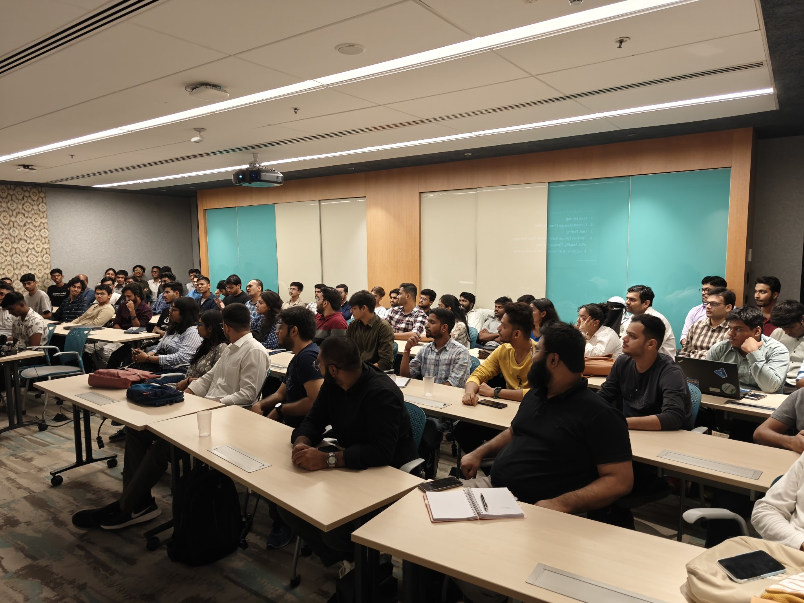
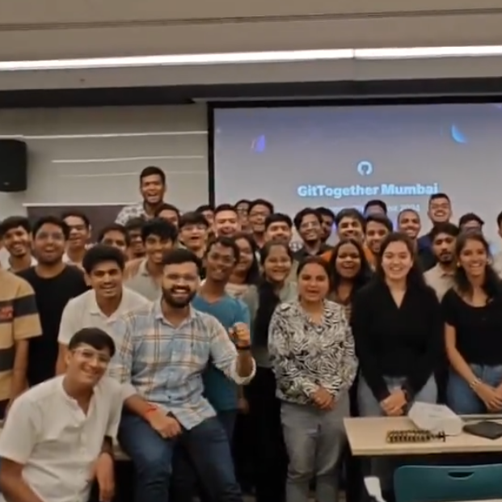
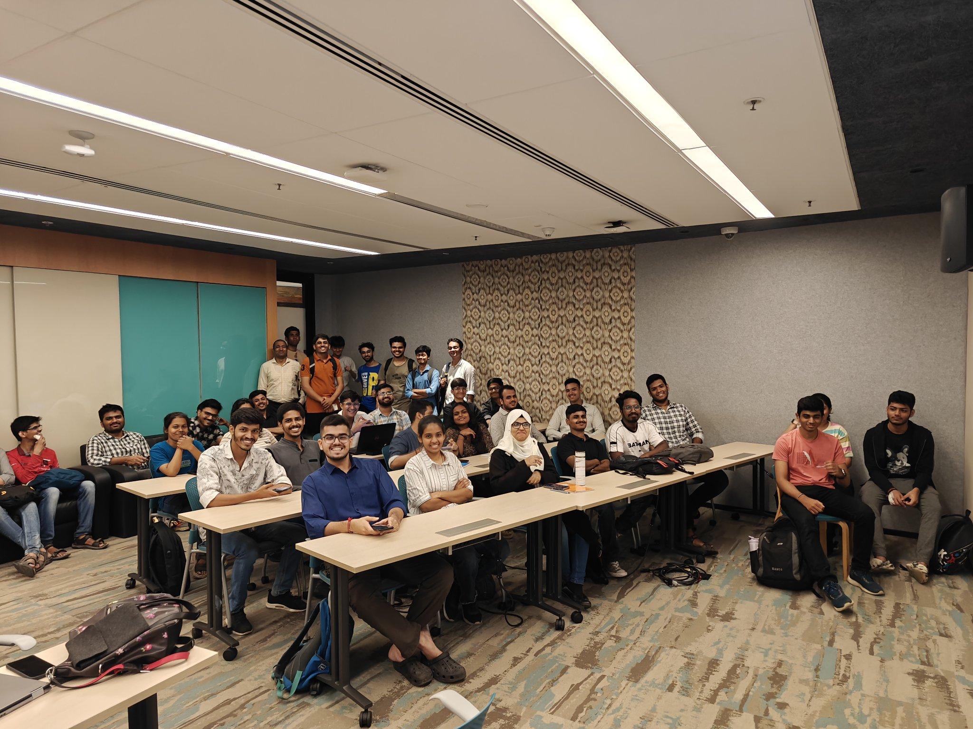
We are almost houseful
Buffer seats are full
Full of Energy
Only standing place available

Slide 6
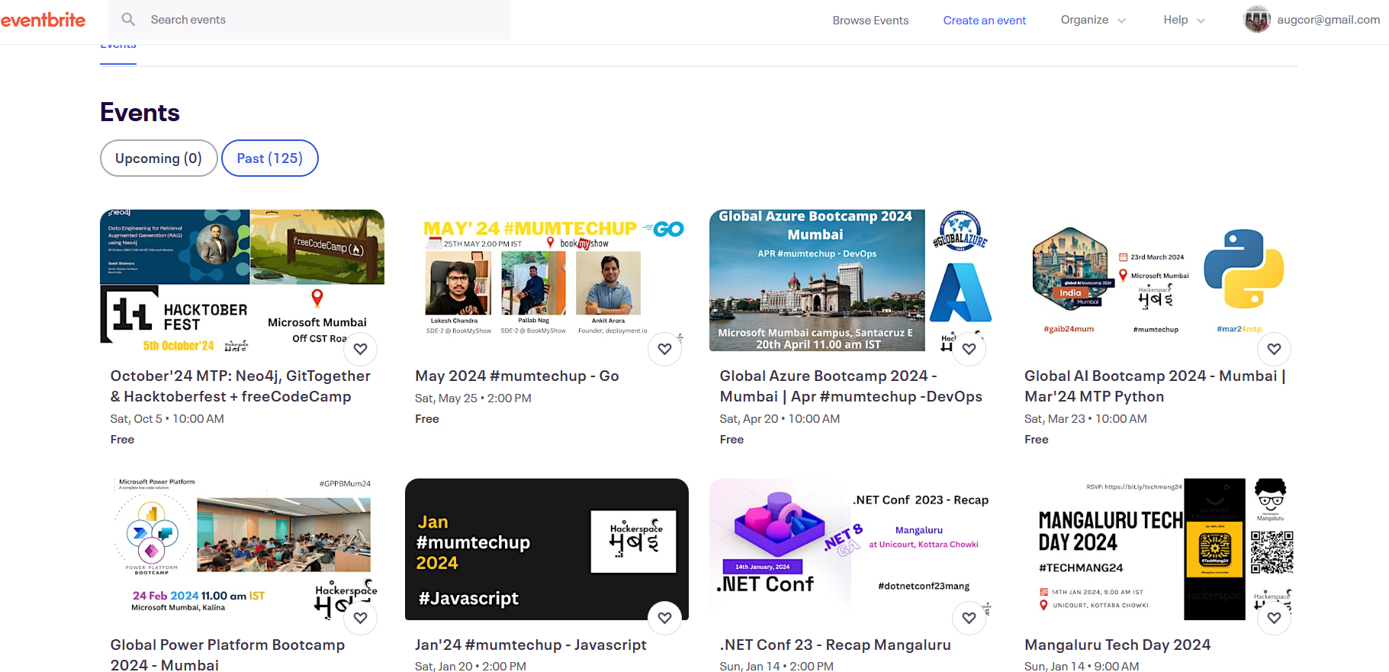
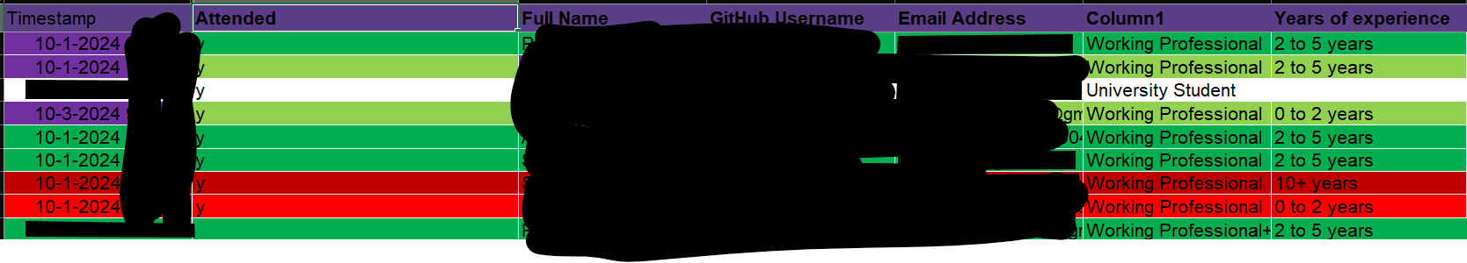

Slide 7

02
Who are you going to call?

Slide 8
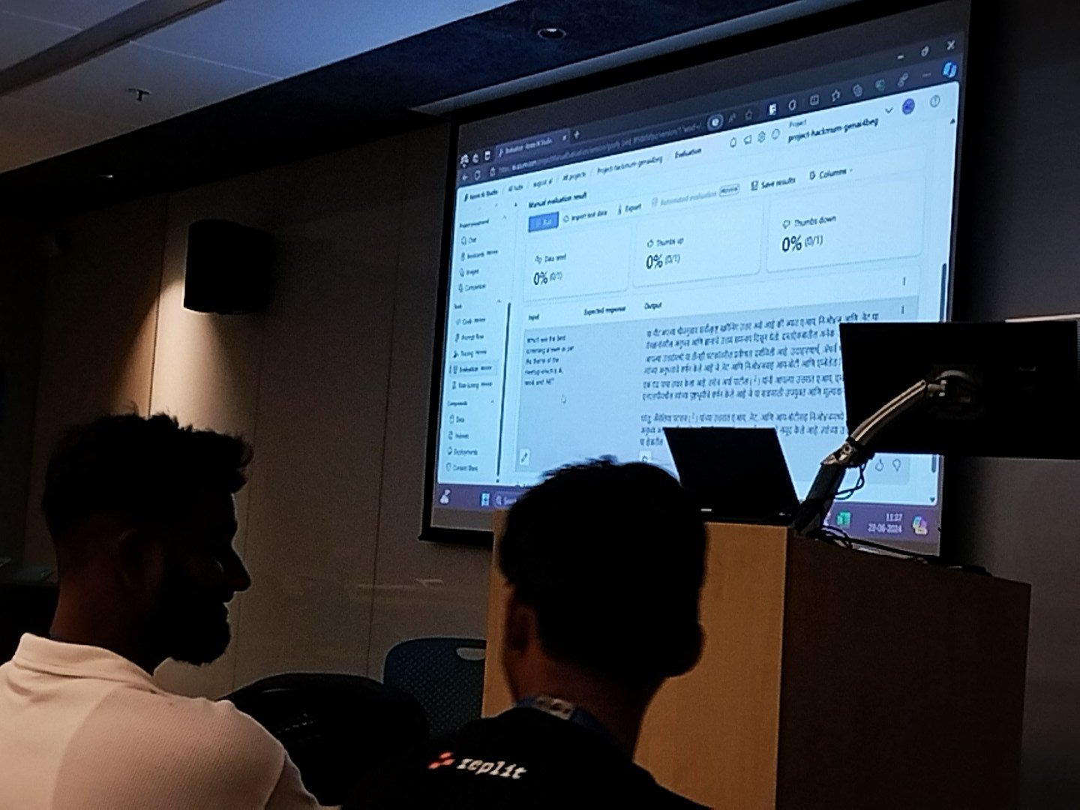
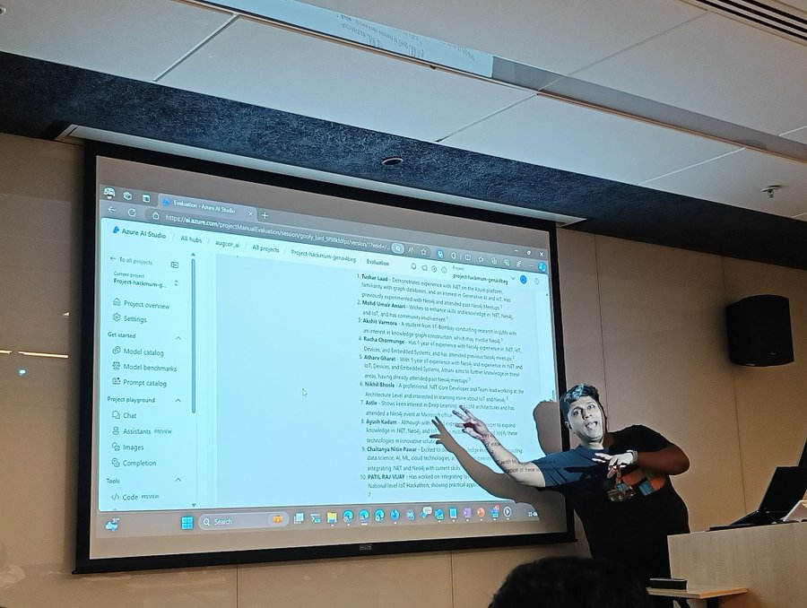

Slide 9
Copilot Workspace
Demo

Slide 10
Aspire: Its just not .NET
Demo

Slide 11
Resources
hackmum.in
https://github.com/HackerspaceMumbai/Visage
Blog that chronicles the development of Visage
GitHub repository. Contributors welcome 🙏
x.com/augvcor
Fb.com/hackmum
My Twitter handle that will have threads of various development in Visage
Our community’s FB page
x.com/hackmum
https://www.linkedin.com/company/hackerspace-mumbai
Community’s X handle
Community’s LinkedIn Profile
https://www.youtube.com/c/hackerspacemumbai
https://www.meetup.com/mumbai-technology-meetup/
Community’s YouTube Channel
Our community’s meetup group

Slide 12
Thank you

